Slide 1
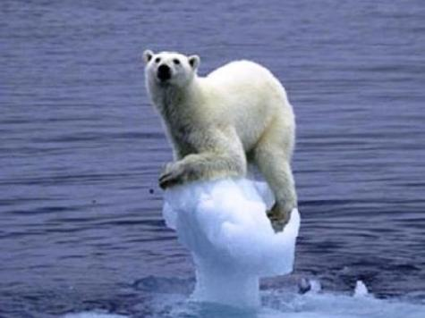
CLIMATE CHANGE & Marine Fisheries Managemnt

Slide 2
Section A
Climate Change Science

Slide 3
What Is Climate?
Weather
“What is happening in the atmosphere at any given time”
Climate
“Average weather over longer time frames”
Notes:
It is important to understand the difference between “weather” and “climate”. What is happening in the atmosphere at any given time is considered “weather” (including e.g. wind speed and direction, precipitation, barometric pressure, temperature, and relative humidity). Weather changes in the short term (e.g. daily, weekly, monthly). Climate is average weather and occurs over long time frames (e.g. 30 years). A common confusion between weather and climate arises when scientists are asked how they can predict climate 50 years from now when they cannot predict the weather a few weeks from now. The chaotic nature of weather makes it unpredictable beyond a few days. Projecting changes in climate (i.e., long-term average weather) due to changes in atmospheric composition or other factors is a very different and much more manageable issue. As an analogy, while it is impossible to predict the age at which any particular man will die, we can say with high confidence that the average age of death for men in industrialised countries is about 75.
IPCC (2007): Frequently Asked Questions - What is the Relationship between Climate Change and Weather?
Further information:
The IPCC defines climate as follows: “Climate in a narrow sense is usually defined as the average weather, or more rigorously, as the statistical description in terms of the mean and variability of relevant quantities over a period of time ranging from months to thousands or millions of years. The classical period for averaging these variables is 30 years, as defined by the World Meteorological Organization. The relevant quantities are most often surface variables such as temperature, precipitation and wind. Climate in a wider sense is the state, including a statistical description, of the climate system.”
IPCC (2013). Climate Change 2013: The Physical Science Basis, Working Group I Contribution to the IPCC Fifth Assessment Report, Glossary

Slide 4
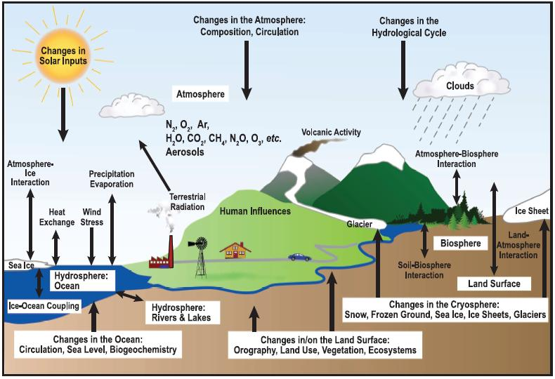
Complexity of the Global
Climate System
Source: IPCC 2007, p96. Further information: WMO Website
Natural and human factors that have an influence on the climate
WMO: World Meteorological Organization
Notes:
In a broader sense, climate is the status of the climate system which comprises the atmosphere, the hydrosphere, the cryosphere, the surface lithosphere and the biosphere. These elements all determine the state and dynamics of the Earth’s climate. The graphic illustrates a number of both natural and human factors that have an influence on the climate. An important mechanism within the climate system is the greenhouse effect which is explained in the following slide.
IPCC (2007). Climate Change 2007: The Physical Science Basis
Further information:
The atmosphere is the envelope of gas surrounding the Earth. The hydrosphere is the part of the climate system containing liquid water at the Earth’s surface and underground (e.g. oceans, rivers, lakes…). The cryosphere contains water in its frozen state (e.g. glaciers, snow, ice…). The surface lithosphere is the upper layer of solid Earth on land and oceans supporting volcanic activity which influence climate. The biosphere contains all living organisms and ecosystems over the land and in the oceans.
World Meteorological Organization (WMO) website

Slide 5
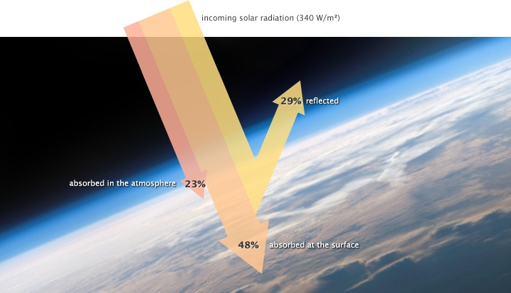
Incoming solar radiation

Slide 6
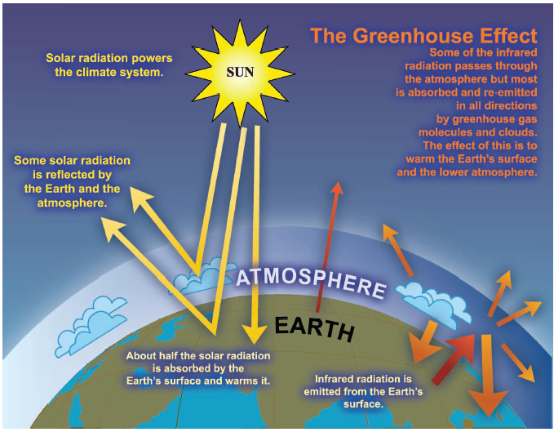
What Is the Greenhouse Effect?
Source: IPCC 2007. Further info: WMO Website
Notes:
The temperature of the Earth results from a balance between energy coming into the Earth from the Sun (solar radiation) and the energy leaving the Earth into outer space. About half the solar radiation striking the Earth and its atmosphere is absorbed at the surface. The other half is reflected back into space by clouds, small particles in the atmosphere, snow, ice and deserts at the Earth’s surface. Part of the energy absorbed at the Earth’s surface is re-admitted to the atmosphere and space in the form of heat (or thermal) energy. The temperature we feel is a measure of this heat energy. In the atmosphere, not all thermal radiation emitted by the Earth reaches outer space. Part of it is absorbed and reflected back to the Earth’s surface by greenhouse gas (GHG) molecules and clouds (the greenhouse effect) leading to a global average of around 15°C, well above the -18°C which would be felt without the natural greenhouse effect. The concentrations of some GHGs, such as carbon dioxide (CO₂), are significantly influenced by humans, others (such as water vapor) are not.
Further information:
The two most abundant gases in the atmosphere, nitrogen (comprising 78% of the dry atmosphere) and oxygen (comprising 21%), exert almost no greenhouse effect. Instead, the greenhouse effect comes from molecules that are more complex and much less common. Water vapour is the most important greenhouse gas, and carbon dioxide (CO₂) is the second-most important one. Methane, nitrous oxide, ozone and several other gases present in the atmosphere in small amounts also contribute to the greenhouse effect. [Source: IPCC]

Slide 7

Video on the Greenhouse Effect
Video:
Understand how
water vapor,
carbon dioxide, and
other gases
cause the Earth’s greenhouse effect
https://www.youtube.com/watch?v=ZzCA60WnoMk
Earth’s average surface temperature: 15°C
Earth surface temp. without Climate Gases: -18°C
Notes:
Do you know how the greenhouse effect maintains the surface temperature of the Earth?
Greenhouse effects is a natural and expected phenomenon. Without greenhouse effects the wold become around 30 colder than it is now.

Slide 8
Climate Change and Global Warming
Global Warming
overall warming of the planet, based on average temperature over the entire surface of the Earth
Climate Change
changes in climate characteristics, including temperature, humidity, rainfall, wind, and severe weather events over long term periods
Further information: WMO Website

Slide 9
The main causes of global warming
Increased concentration of greenhouse gases in the atmosphere since the industrial revolution in the late 18th century
Atmosphere warms due to rising levels of greenhouse gases, as a result-
  concentration of water vapour increases, further intensifying the greenhouse effect
  this in turn causes more warming, which causes an additional increase in water vapour
  this water vapour feedback doubles the increase in the greenhouse effect due to the added CO₂ alone
Further information: WMO Website
Notes:
Since the beginning of the 20th century, scientists have been observing a change in the climate that can not be attributed to any of the “natural” influences of the past only. This change in the climate, also known as global warming, has occurred faster than any other climate change recorded by humans.
The main cause of global warming is the increased concentration of greenhouse gases in the atmosphere since the industrial revolution in the late 18th century. The increased amount of gases which absorb and re-emit thermal radiation, has directly led to more heat being retained in the atmosphere and thus an increase in global average surface temperatures. The increase in temperature is also leading to other effects on the climate system. Together these affects are known as anthropogenic (human caused) climate change.
WMO website
Further information:
Adding more of a greenhouse gas, such as CO_{2,} to the atmosphere intensifies the greenhouse effect, thus warming Earth’s climate. The amount of warming depends on various feedback mechanisms. For example, as the atmosphere warms due to rising levels of greenhouse gases, its concentration of water vapour increases, further intensifying the greenhouse effect. This in turn causes more warming, which causes an additional increase in water vapour, in a self-reinforcing cycle. This water vapour feedback may be strong enough to approximately double the increase in the greenhouse effect due to the added CO₂ alone.
IPCC (2007): Frequently Asked Questions - What is the Greenhouse Effect?

Slide 10
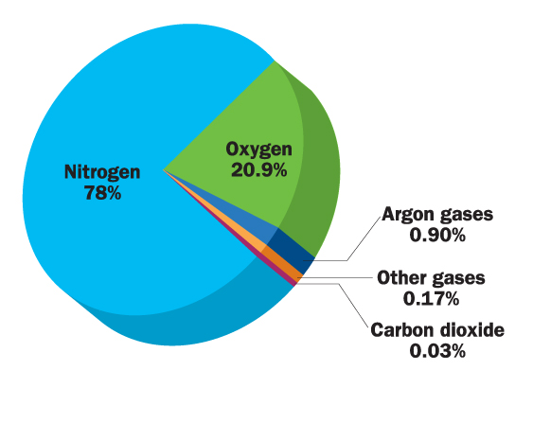
CO2 in atmosphere
The amount of CO2 in atmosphere has been increasing ➔ it is now > 0.04% = > 400 ppm

Slide 11
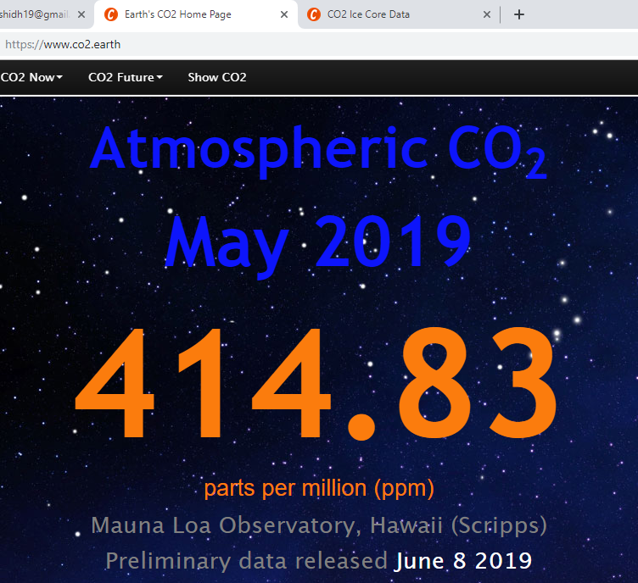

Slide 12
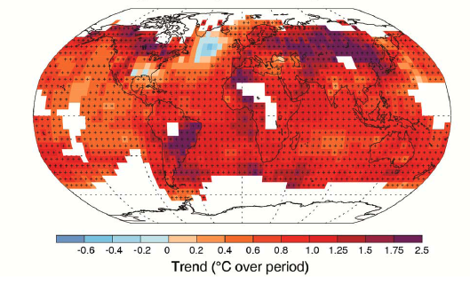
Observed Change in Surface Temperature (1901–2012)
Source: IPCC 2013, p4
1880 – 2012:
average global surface temperature has increased by 0.85°C
Notes:
This diagram gives an indication of the observed change in average surface temperature between 1901 and 2012. It shows that almost the entire globe has experienced surface warming.
According to the IPCC, the average global surface temperature has increased by 0.85°C over the period 1880 to 2012.
IPCC (2013). Climate Change 2013: The Physical Science Basis - Summary for Policymakers, p3

Slide 13
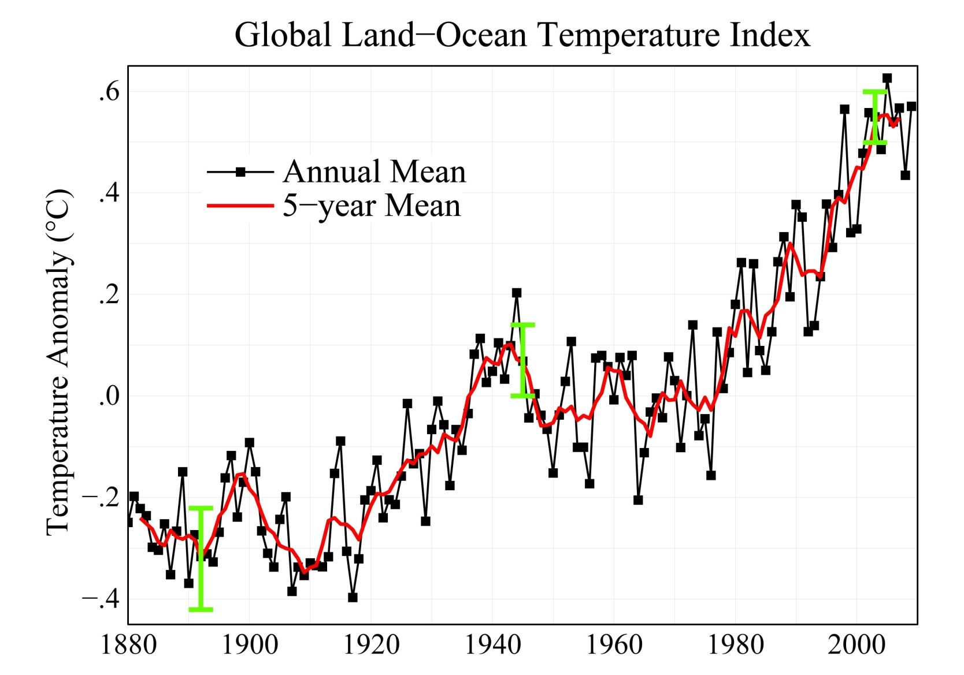
Except for a leveling off between the 1940s and 1970s, Earth's surface temperatures have increased since 1880 ➔ 0.85C increase

Slide 14
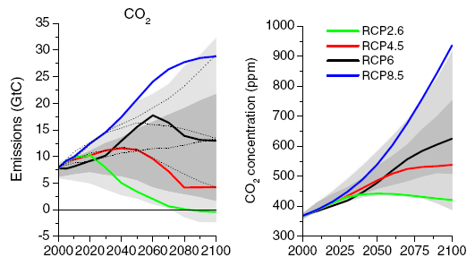
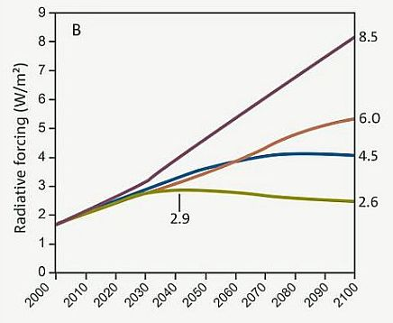
14
Radiative forcing for the different RCPs. The numbers on the right show the final radiative forcing at 2100 and give each scenario its name (2.6, 4.5, 6.0 and 8.5 W/m²)

Slide 15
Climate Change Has an Impact on:
Ecosystems
Biodiversity, carbon storage, habitats,
Human systems
Agriculture, Aquaculture, freshwater, health,
Urban systems
Transport, buildings, lifestyle, …
Economic systems
Energy, manufacturing, natural capital industries, …
Social systems
Equity, migration, peace and conflict, …
Notes:
Climate change has an impact on almost every aspect of our lives. Our ecosystems suffer biodiversity and habitat loss and human systems like health will be negatively impacted, for example by the spread of disease vectors like mosquitos. Climate change also challenges us to rethink our urban systems (including transport and buildings) and the way we do business (including green business opportunities). The impacts of climate change might also result in conflict or force people to migrate (for example from low-lying coastal areas).

Slide 16
International CC Organizations/Frameworks
UNFCCC:
United Nations Framework Convention on Climate Change is an international environmental treaty negotiated at the Earth Summit in Rio de Janeiro from 3 to 14 June 1992, then entered into force on 21 March 1994.
With 197 Parties, the UNFCCC has near universal membership and is the parent treaty of the 1997 Kyoto Protocol. The Kyoto Protocol has been ratified by 192 of the UNFCCC Parties.

Slide 17
International CC Organizations/Frameworks
IPCC:
The Intergovernmental Panel on Climate Change (IPCC) is the international body for assessing the science related to climate change.
The IPCC was set up in 1988 by the World Meteorological Organization (WMO) and United Nations Environment Programme (UNEP) to provide policymakers with regular assessments of the scientific basis of climate change, its impacts and future risks, and options for adaptation and mitigation.

Slide 18
International CC Organizations/Frameworks
UNEP:
United Nations Environment Program

Slide 19
History of Climate Change Science
1861
Indication that CO₂ and H₂O can cause changes in the climate
1895
First proposal of the idea of a man-made greenhouse effect
1938
Proof that doubling of atmospheric CO₂ concentration results in an increase in the mean global temperature of 2°C
1950s
Start of interdisciplinary field of carbon cycle science
1958
The high-accuracy measurements of atmospheric CO₂ concentration
1970s
Other greenhouse gases widely recognized
1979
The first World Climate Conference in Geneva
1988
Establishment of Intergovernmental Panel on Climate Change (IPCC)
1990
The first IPCC report
Argument raised that the temperature of the Earth can be augmented by the interposition of the atmosphere
1824
Further information: BBC Website
Notes:
As far back as 1824, the French physicist Joseph Fourier is the first to describe the Earth’s natural “greenhouse effect”. In 1861, the Irish physicist John Tyndall shows that CO₂ and H₂O can cause changes in the climate. In 1895, Swedish chemist Svante Arrhenius concludes that industrial-age coal burning will enhance the natural greenhouse effect. In 1938 the British engineer Guy Callendar shows that temperatures had risen over the previous century due to increased CO₂ concentrations. The "Callendar effect" is widely dismissed. In 1958 the geochemist Charles David Keeling was employed to continuously monitor CO₂ levels in the atmosphere, with an increase in Antarctica visible after only two years. During the 1970’s other greenhouse gases, CH₄, N₂O and CFCs, were widely recognized as important anthropogenic greenhouse gases and in 1979 the First World Climate Conference was held in Geneva, leading to the establishment of the World Climate Programme. In 1988 the Intergovernmental Panel on Climate Change (IPCC) was set up by the World Meteorological Organization (WMO) and the United Nations Environment Program (UNEP). In 1990 the IPCC delivered its First Assessment Report on the state of climate change, predicting an increase of 0.3 °C each decade in the 21st century.
IPCC (2007). Fourth Assessment Report, Chapter One - Historical Overview of Climate Change Science
Zillman, J. (2009). A History of Climate Activities
Knight, M. for CNN (2008). A Timeline of Climate Change Science
BBC Website

Slide 20
IPCC Video on the Human
Influence on the Climate System
Video:
The video summarizes the main findings of the 2013 IPCC Report on the physical science basis of climate change.
https://www.youtube.com/watch?v=6yiTZm0y1YA&feature=youtu.be
Notes:
The Intergovernmental Panel on Climate Change (IPCC) has produced a video on the physical science basis of climate change. It looks at evidence of how the climate has changed in the past and present, what the causes of these changes are, and what possible future scenarios exist.

Slide 21
Section B
Anthropogenic Drivers of
Climate Change
Notes:
This section discusses the main driver of anthropogenic climate change, i.e. the increased concentration of greenhouse gases in the atmosphere. The section starts with an overview of the most important greenhouse gases emitted by humans. It then discusses each gas in more detail, looking at (1) how significant the gas is in terms of global warming, and (2) how its concentration in the atmosphere has developed over time. The section concludes with a graph depicting the extent of the human influence on the climate system.

Slide 22
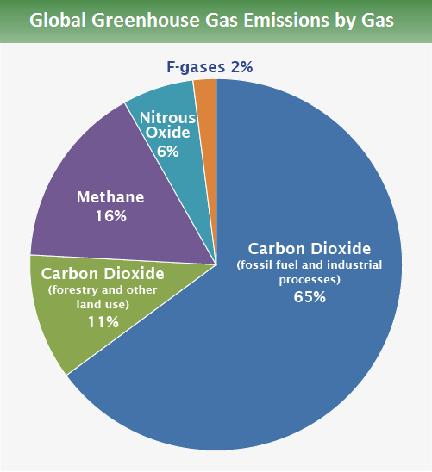
Source: IPCC 2014

Slide 23
Overview of Greenhouse Gases Regulated under the Kyoto Protocol (1997)
Greenhouse Gas | Global Warming Potential (GWP*) (over 100 years) | % of Total Anthropogenic GHG Emissions (2010)
Carbon dioxide (CO₂) | 1 | 76%
Methane (CH₄) | 25 | 16%
Nitrous oxide (N₂O) | 298 | 6%
Hydrofluorocarbons (HFCs) | 124-14,800 | ca. 2%
Perfluorocarbons (PFCs) | 7,390-12,200
Sulphur hexafluoride (SF₆) | 22,800
Nitrogen trifluoride (NF₃) | 17,200
*GWP= capacity to trap heat in the atmosphere
Source: Reproduced from IPCC 2007 and UNEP 2012
are also called long-lived greenhouse gases (LLGHGs)
Notes:
Greenhouse gases (GHGs) are trace gases in the atmosphere that absorb and emit long wave radiation. They naturally blanket the earth and keep it at about 33° C warmer than it would be without these gases in the atmosphere. The table features the seven most important greenhouse gases as regulated under the Kyoto Protocol (1997). The seven gases each have a different capacity to trap heat in the atmosphere, or a so-called “global warming potential” (GWP). They all belong to the group of long-lived greenhouse gases (LLGHGs), because they are chemically stable and persist in the atmosphere over time scales of a decade to centuries or longer, so that their emission has a long-term influence on climate. Some of the GHGs occur naturally (e.g. CO₂, CH₄ and N₂O) but increases in their atmospheric concentrations over the last 250 years are due largely to human activities. Other greenhouse gases are entirely the result of human activities (e.g. HFCs, PFCs, SF₆ and NF₃).
IPCC (2007). Fourth Assessment Report, Technical Summary – Changes in Human and Natural Drivers of Climate
UNEP (2012). Emissions Gap Report
Further information:
Kyoto Protocol: The Kyoto Protocol sets out legally binding targets for developed countries to limit or reduce their GHG emissions. It was adopted in 1997 and entered into force in 2005. Water vapor is the most important greenhouse gas but since it is not produced by humans in any significant quantity, we have no control over its concentration in the atmosphere. It is therefore not regulated under the Kyoto Protocol.
Global Warming Potential (GWP): Carbon dioxide is the baseline unit to which all other greenhouse gases are compared and therefore has a GWP of exactly 1. A GWP is calculated over a specific time interval (commonly 20, 100 or 500 years), because some gases remain longer in the atmosphere than others. For example, the 100 year GWP of methane is 25, which means that if the same mass of methane and carbon dioxide were introduced into the atmosphere, that methane will trap 25 times more heat than the carbon dioxide over the next 100 years.

Slide 24
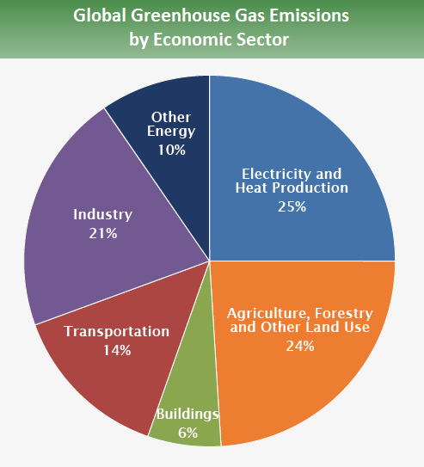
Source: IPCC 2014

Slide 25
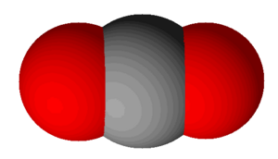
Important Greenhouse Gases:
Carbon Dioxide (CO₂)
Most important greenhouse gas (contributes ~64% to total radiative forcing by long-lived GHGs)
Half of CO₂ emitted by human activities is being absorbed in the biosphere and oceans
Rest half remains in the atmosphere for hundreds to thousands of years
Source: WMO 2013
Notes:
The most important anthropogenic GHG is carbon dioxide (CO₂). It accounts for around 64% of total radiative forcing due to LLGHGs. Carbon dioxide does not have a specific lifetime because it is continuously cycled between the atmosphere, oceans and land biosphere and its net removal from the atmosphere involves a range of processes with different time scales. CO₂ is primarily emitted as a result of burning of fossil fuels, deforestation and forest degradation and iron and steel production. Oceans and forests are the main sequesters of carbon i.e sinks that can absorb CO₂ from the atmosphere. Carbon dioxide is the gas to which all other gases are compared when speaking of Global Warming Potential. Emissions of other greenhouse gases can be converted into CO₂ equivalent emissions.
IPCC (2007). Fourth Assessment Report, Technical Summary – Changes in Human and Natural Drivers of Climate
WMO (2013). Greenhouse Gas Bulletin
Further information:
The contribution of each greenhouse gas to radiative forcing is determined by its global warming potential and the change in its concentration in the atmosphere over time.

Slide 26
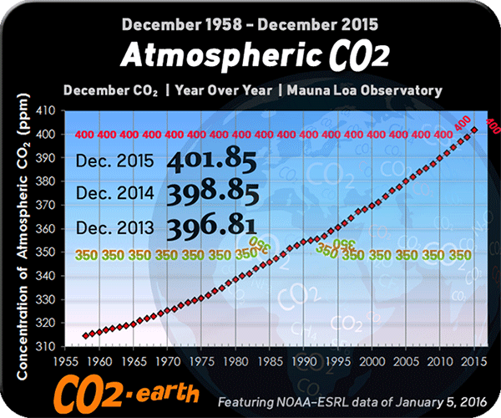
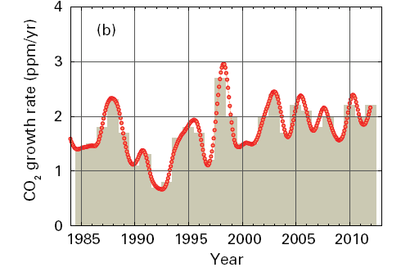
CO₂ Concentration in the Atmosphere and Annual Growth Rates
Since 1750
CO₂ concentration in the atmosphere has increased by 40%
1. Increased use of fossil fuel
2. Increase in deforestation
→ release of CO₂ into atmosphere
Source: WMO 2013
Notes:
CO₂ levels in the atmosphere have been increasing steadily over the past 200 years. This is due to the increased use of fossil fuels as well as an increase in deforestation, both of which release vast amounts of CO₂ into the atmosphere. Today’s concentration of CO₂ is believed to be the highest it has been in the past 800,000 years. CO₂ concentrations increased by about 100 ppm (parts per million) since the industrial revolution and exceeded the symbolic 400 ppm threshhold at several atmosphere watch stations during 2012. Figure [left] shows the increase in CO₂ concentrations between 1955 and 2015. Figure [right] shows the annual growth rate of CO₂ concentrations during 1985 - 2012.
WMO (2013). Greenhouse Gas Bulletin, p3
WMO (2013). Greenhouse Gas Concentrations in Atmosphere Reach New Record

Slide 27
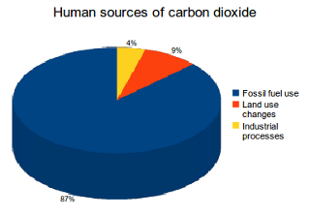
Anthropogenic Drivers of CO2
Source:
Le Quéré, C. et al. (2013). The global carbon budget 1959-2011.

Slide 28
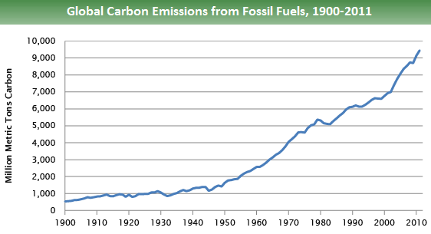
Source:
Boden, T.A., Marland, G., and Andres R.J. (2015). Global, Regional, and National Fossil-Fuel CO₂ Emissions.

Slide 29
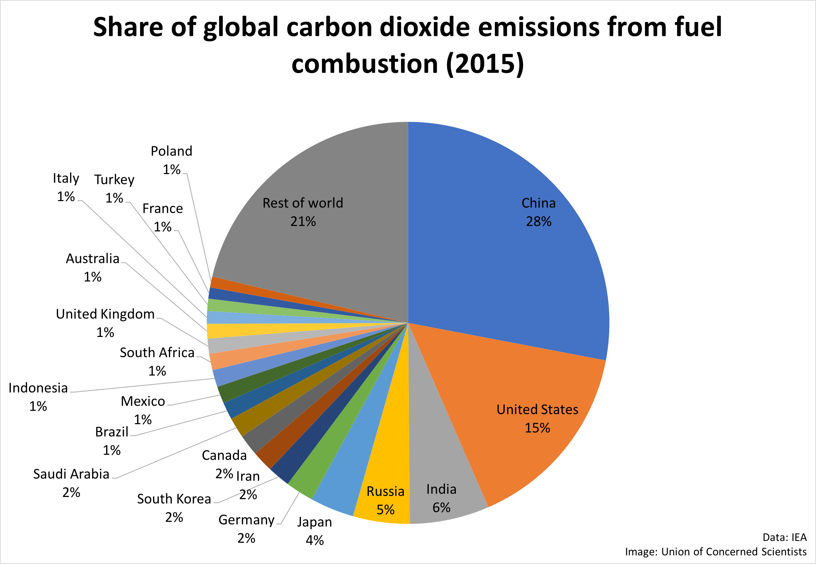
CO2 Emission by Country
Notes:
IEA: https://www.iea.org/
Source: Boden, T.A., Marland, G., and Andres, R.J. (2015). National CO₂ Emissions from Fossil-Fuel Burning, Cement Manufacture, and Gas Flaring: 1751-2011

Slide 30
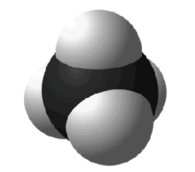
Important Greenhouse Gases:
Methane (CH₄)
Second most significant greenhouse gas (contributes ~18% to total radiative forcing by Long-Lived GHGs)
Approximately 40% of methane is emitted into the atmosphere by natural sources
About 60% comes from human activities
Stays in the atmosphere for approx.12 years
Source: IPCC 2007 and WMO 2013
Notes:
The second most significant anthropogenic GHG is methane (CH₄) which contributes to approximately 18% of total radiative forcing due to LLGHGs. Approximately 40% of methane is emitted into the atmosphere by natural sources (e.g. wetlands and termites). About 60% comes from human activities (e.g. cattle breeding, rice agriculture, fossil fuel exploitation, landfills and biomass burning). Methane is mostly removed from the atmosphere by chemical reactions, persisting for about 12 years. Thus although methane is an important greenhouse gas, its effect is relatively short-lived.
IPCC (2007). Fourth Assessment Report, Working Group I - The Physical Science Basis
WMO (2013). Greenhouse Gas Bulletin, p3
WMO (2013). Greenhouse Gas Concentrations in Atmosphere Reach New Record

Slide 31
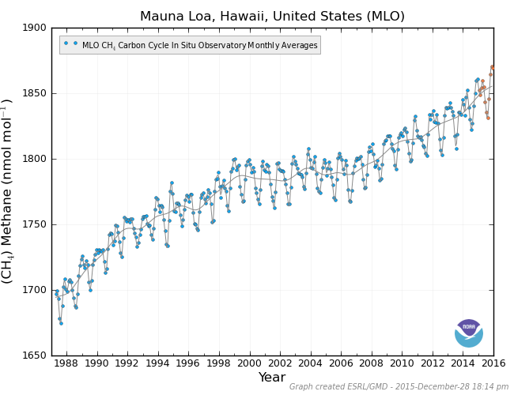
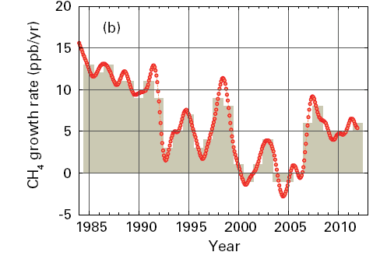
CH₄ Concentration in the Atmosphere and Annual Growth Rates
Atmospheric CH4 conc.
[1988-2015]
Since 1750
CH₄ concentration in the atmosphere has increased by 150%.
# Conc. of CH₄ has more than doubled since pre-industrial times
[1750: 700 ppb] [2015: 1850 ppb]
Source: WMO 2013
Notes:
This slide shows the atmospheric concentration of methane from 1988 to 2015 in left figure, while right figure shows the annually averaged growth rate. The concentration of CH₄ has more than doubled since pre-industrial times (from approximately 700 parts per billion in 1750 to 1819 ppb in 2012 ). Since 2007, atmospheric methane has been increasing again after a temporary period of levelling-off.
WMO (2013). Greenhouse Gas Bulletin, p3
WMO (2013). Greenhouse Gas Concentrations in Atmosphere Reach New Record

Slide 32
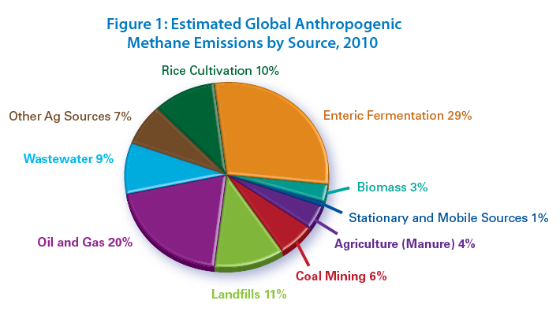
Source: www.globalmethane.org

Slide 33
Section C
Observed Trends &
Impacts of Climate Change
Notes:
This section describes some of the main observed changes in the climate since the industrial revolution. It looks at changes in surface temperature, precipitation levels, ocean warming and acidification, sea-level rise, Arctic sea ice extent, as well as observed changes in physical and biological systems. The section concludes with a discussion of whether the recent increase in extreme weather events (such as cyclones and floods) can be attributed to anthropogenic climate change.

Slide 34
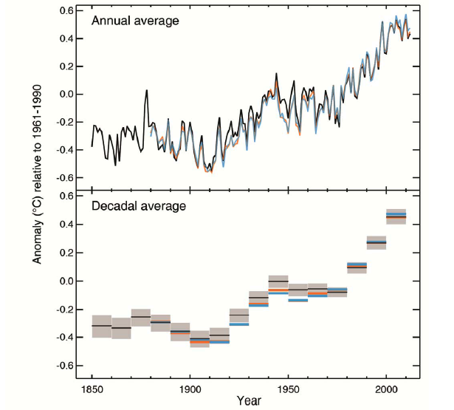
Observed Surface Temperature
Anomaly (1850-2012)
Globally averaged land and ocean
surface temperature
Each of the last three decades has been successively warmer at the Earth’s surface than any preceding decade since 1850
Source: IPCC 2013, p4
Notes:
This figure illustrates how the averaged land and ocean surface temperature has changed between 1850 and 2012. The annual temperature average has always varied, with cold and warm periods alternating. However, it is clear that each of the last three decades has been successively warmer at the Earth’s surface than any preceding decade since 1850.
The temperature increase is widespread across the world, but there are important regional variations. Warming has been most marked in the northern Polar Regions.
IPCC (2013). Climate Change 2013: The Physical Science Basis - Summary for Policymakers , pp 3-4

Slide 35
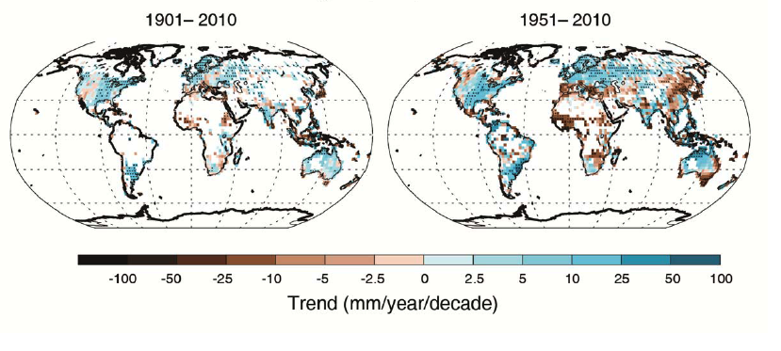
Observed Change in Annual Precipitation Over Land
Source: IPCC 2013, p6
changes are occurring in the amount, intensity, frequency and type of precipitation
Notes:
Observations show that changes are occurring in the amount, intensity, frequency and type of precipitation. These aspects of precipitation generally exhibit large natural variability, and El Niño and other natural climate fluctuations have a substantial influence. Over the past century, however, pronounced long-term trends in precipitation amounts have been observed: significantly wetter in eastern North and South America, northern Europe and northern and central Asia, but drier in the Sahel, southern Africa, the Mediterranean and southern Asia. Moreover, widespread increases in heavy precipitation events have been observed, even in places where total amounts have decreased. The two maps show the observed precipitation change from 1901 to 2010 and 1951 to 2010.
IPCC (2013). Climate Change 2013: The Physical Science Basis - Summary for Policymakers, p3
IPCC (2007): Frequently Asked Questions – How Is Precipitation Changing?

Slide 36
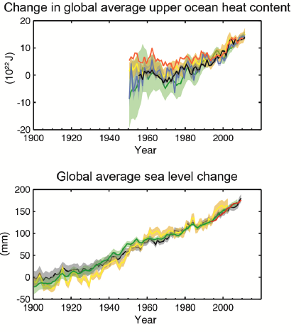
Observed Ocean Warming
(1950-2010)
More than 60% of the net energy increase in the climate system is stored in the upper ocean (period 1971-2010).
Source: IPCC 2013, p8
Ocean warming dominates the increase in energy stored in the climate system
Notes:
Ocean warming dominates the increase in energy stored in the climate system. Oceans account for more than 90% of the energy accumulated between 1971 and 2010. 60% of the net energy increase is stored in the upper ocean (0-700 m) and about 30% is stored in the ocean below 700 m. The ocean warming is largest near the surface, am the upper 75 m warmed by 0.11°C per decade over the period 1971 to 2010.
IPCC (2013). Climate Change 2013: The Physical Science Basis - Summary for Policymakers, p6

Slide 37
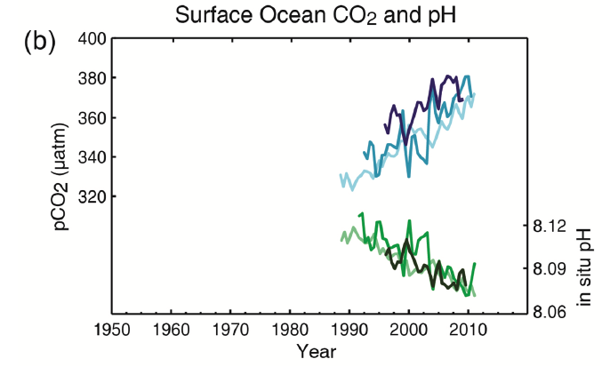
Observed Ocean Acidification
Source: IPCC 2013, p10
30% of anthropogenic CO₂ emissions has been absorbed by the oceans
→ ocean acidification
Notes:
About 30% of anthropogenic CO₂ emissions has been absorbed by the oceans. This leads to ocean acidification. The green curve in the figure shows the decreasing pH of ocean surface water since the late 1980s. According to the IPCC, the pH of ocean surface water has decreased by 0.1 since the beginning of the industrial era.
IPCC (2013). Climate Change 2013: The Physical Science Basis - Summary for Policymakers, p10

Slide 38
Observed Sea Level Rise
(1900 to 2010)
Over the period 1901 to 2010, global mean sea level rose by
0.19m
Source: IPCC 2013, p8
Notes:
The rate of sea level rise since the mid-19th century has been larger than the mean rate during the previous two millennia. Over the past century, global mean sea level rose by 0.19m. Glacier mass loss and ocean thermal expansion from warming together explain about 75% of the observed global mean sea-level rise since the early 1970s.
IPCC (2013). Climate Change 2013: The Physical Science Basis - Summary for Policymakers, p9

Slide 39
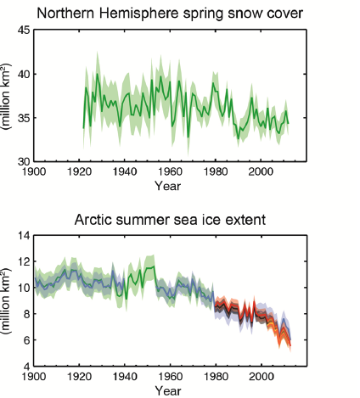
Observed Decrease in Arctic Sea Ice Extent (1900-2010)
Source: IPCC 2013, p8
Notes:
Over the last two decades, the Greenland and Antarctic ice sheets have been losing mass, glaciers have continued to shrink almost worldwide, and Arctic sea ice has continued to decrease in extent. The graph illustrates the decrease in summer sea ice extent in the Artic between 1900 and 2010. The spatial extent has decreased in every season since 1979.
IPCC (2013). Climate Change 2013: The Physical Science Basis - Summary for Policymakers, p7

Slide 40
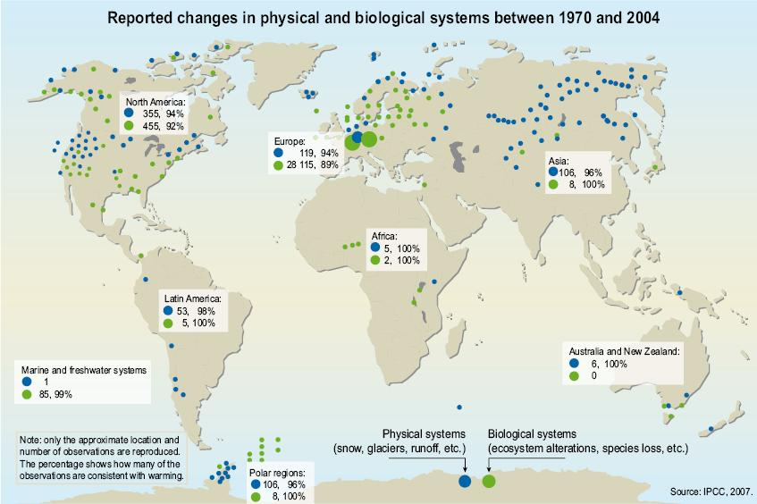
Observed Changes in Physical and Biological Systems
Green: bio
Blue: physical
-------------
Biological
Species loss
ecosystem alteration
-------------
Physical
Snow cover
Glacier density/cover
Glacier runoff
Source: UNEP 2009, p13
Notes:
This slide shows a number of changes that have been observed in physical (blue) and biological (green) systems between 1970 and 2004. Biological changes include, for example, species loss and ecosystem alterations. Physical changes include, for example, changes in snow cover, changes in glacier density/coverage and run-off. The percentages associated with the observations indicate how many of the reported changes are due to a warming environment.
UNEP (2009). Climate in Peril

Slide 41
Impacts of CC on Marine Fishery

Slide 42
Impacts of CC on Marine Fishery
CC impacts on aquatic systems
  Hydrological cycle & rainfall patter → impacts
  Water temperature
  Salinity
  Oxygen content
  Sea level
  Ocean circulation
  Ocean acidification
  Primary production
  Coastal-marine ecosystems

