Slide 1
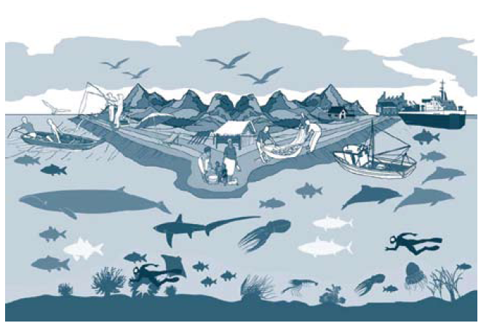
Marine Fisheries Management & Conservation: MPA
MFM JD 2018

Slide 2
What is an MPA?
Any marine geographical area
that is afforded greater protection
  than the surrounding waters
for biodiversity conservation
or fisheries management purposes
      will be considered an MPA.

Slide 3
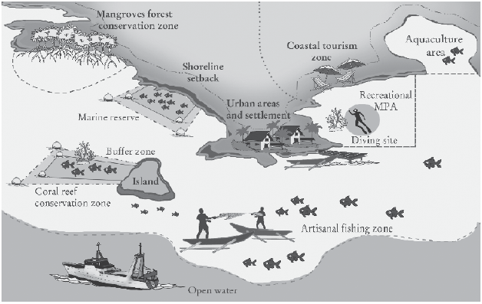
What is an MPA?
Notes:
Shoreline setback: Coastal setbacks are ‘a prescribed distance to a coastal feature such as the line of permanent vegetation, within which all or certain types of development are prohibited (Cambers, 1998). A setback may dictate a minimum distance from the shoreline for new buildings or infrastructure facilities, or may state a minimum elevation above sea level for development. Elevation setbacks are used to adapt to coastal flooding, while lateral setbacks deal with coastal erosion.

Slide 4
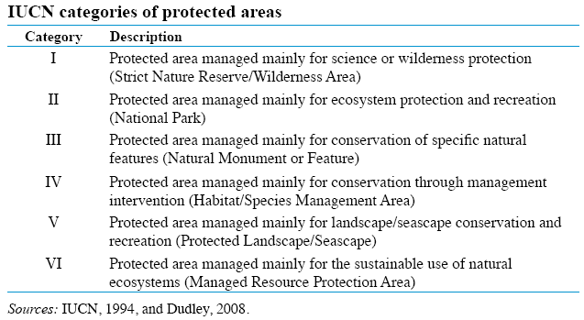
MPA Categories

Slide 5
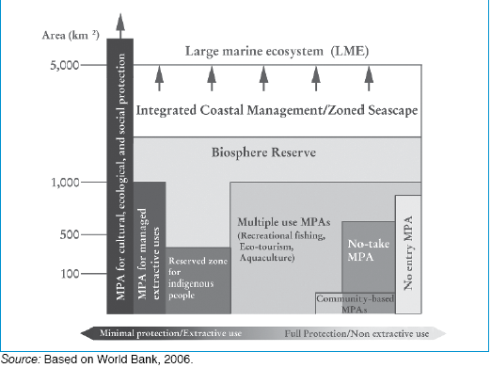
WHAT ARE THE PRIMARY REASONS FOR ESTABLISHING MPAs?

Slide 6
Objectives of Establishing MPA
DIRECT OBJECTIVES for establishing MPAs:
rebuilding fish stocks;
ensuring sustainability of fish stocks & fisheries;
protection of marine biodiversity and critical habitats;
support local & traditional sustainable marine-based lifestyles & communities;
increase resilience (Av‡Mi Ae¯’vq wd‡i Avmvi ¸Yvejx) to climate & other environmental changes;
facilitate the resolution of multiple stakeholder conflicts;
facilitate scientific research, education & recreation;
protect cultural and archaeological sites.

Slide 7
B. INDIRECT OBJECTIVES for establishing MPAs:
creating opportunities for alternative uses and thereby helping diversify the economy
  e.g.
    through tourism
    biodiversity conservation work
    recreational fisheries
  → reduce stress on fish stocks
provide a hedge (‡eov/†Svc) against uncertainty;

Slide 8
B. INDIRECT OBJECTIVES for establishing MPAs:
raising awareness of the importance of certain places
  in supporting –
        fisheries production & biodiversity conservation
providing a demonstration of the successful integration of -
  management across sectors and
  achievement of multiple goals
      E.g. –
        for instance,
        maintaining fisheries
        conserving biodiversity

Slide 9
STEPS towards establishing an MPA
Step 1: Identification of Areas of Significance (AOSs)
Step 2: Initial screening of preliminary selected AOSs
Step 3: AOSs validation, assessments and suggestions
Step 4: Formulation of a Management Plan for a Candidate MPA Site
Step 5: Designation of MPA
Step 6: Guidelines of management of MPAs within a framework
Step 7: Declaration of MPA
Step 8: Code of Conducts (COC) for specialized MPA

Slide 10
Factors Determining Effects of MPA
Some key factors determining the protective effects of MPAs on fishery resources include:
1. MPA Location:
The location of an MPA determines what it protects.
  The more concentrated the fishery resources, habitat or biodiversity in the MPA location → the more protection the MPA provides.
Conversely, placing an MPA where there are fewer organisms to protect provides proportionally less protective benefit.
The networking benefits of MPAs are also determined by the location of MPAs relative to each other (their connectivity).

Slide 11
2. Size, Number and Area of MPA:
The size of an MPA and the number of MPAs in a network – and the total area they cover – are also factors determining their effect.
Obviously, the larger the total area protected → the greater the protective benefit, all other factors being equal.
Multiple independent or unconnected MPAs of the same total size will be less able to sustain a population.
        However, if the smaller MPAs are connected they may be better at sustaining a population.

Slide 12
3. Nature of Protection:
The nature of protection in an MPA determines the effect on species and habitats.
MPAs that prohibit all human extractive activity within their boundaries
      → provide greater conservation benefit than MPAs that allow some activity, such as fishing with certain gears or for specific species.

Slide 13
4. Movement of Animals:
The effectiveness of MPAs is also determined by the movement of animals in and out of MPAs.
Less movement means more protection for the species or population within the MPA.
However, MPAs may benefit populations and fisheries beyond their borders by –
  exporting eggs and larvae to support recruitment outside MPAs,
  and
  by migration of legal-sized individuals, so that they can add to the fishery resources outside MPAs.

Slide 14
5. Activities Outside MPA:
Even with complete protection inside an MPA, benefits may be jeopardized by activities outside the MPA.
The greater the fishing pressure on stock outside MPA boundaries, the larger the portion of stock protected by MPAs must to be sustained the resources being fished.
Also, activities outside MPAs that degrade habitat and water quality may undermine the effectiveness of MPAs (e.g. because water quality will not honour MPA boundaries).
The effects of the MPA are conditioned by the effectiveness of management of all human activities, including fisheries, outside of the MPA.

Slide 15
FISHERIES MANAGEMENT & CONSERVATION &
ECOSYSTEM APPROACH TO FISHERIES (EAF)

Slide 16
FISHERIES MANAGEMENT & CONSERVATION AND
ECOSYSTEM APPROACH TO FISHERIES (EAF)
FAO Definition of EAF:
# An ecosystem approach to fisheries strives to balance diverse societal objectives,
# by taking into account the knowledge and uncertainties about biotic, abiotic and human components of ecosystems and their interactions
and
# applying an integrated approach to fisheries within ecologically meaningful boundaries.

Slide 17
Criteria |  | Conventional Fisheries management | EAF
Paradigm (pattern) |  | Sector-based. Vertically integrated. Focusing on target resource and people. | Area-based. Holistic. Loosely cross-sectoral. Focusing on habitats and ecosystem integrity.
Governance | Objectives | Not always coherent or transparent. “Optimal” system output. Social peace. | A desired state of the ecosystem (health, integrity).
 | Scientific input | Formalized (particularly in regional commissions). Variable impact. | Less formalized. Less operational. Often insufficient. Stronger role of advocacy science.
 | Decision- making | Most often top-down. Strongly influenced by industry lobbying. Growing role of environmental NGOs. | Highly variable. Often more participative. Strongly influenced by environmental lobbies. Stronger use of tribunals.
 | Role of the media | Historically limited. Growing as fisheries crisis spreads. | Stronger use of the media.
 | Regional and global institutions | Central role of the Food and Agriculture Organization of the UN and regional fishery bodies. | Central role of United Nations Environment Programme (UNEP) and the Regional Seas Conventions.
Conventional Fisheries Management vs EAF

Slide 18
Criteria | Conventional Fisheries management | EAF
Geographical basis | A process of overlapping and cascading subdivision of the oceans for allocation of resources and responsibilities. | A progressive consideration of larger-scale ecosystems for more comprehensive management, e.g. from specific areas to entire coastal zones and Large Marine Ecosystems (LME).
Stakeholder and political base | Narrow. Essentially fishery stakeholders. Progressively opening to other interests. | Much broader. Society-wide. Often with support from recreational and small-scale fisheries.
Global instruments | 1982 Law of the Sea Convention, UN Fish Stock Agreement and FAO Code of Conduct. | Ramsar Convention, UN Conference on Environment and Development and 1992Agenda 21, Convention on Biological Diversity and Jakarta Mandate.
Measures | Regulation of human activity inputs (gear, effort, capacity) or output (removals, quotas) and trade. | Protection of specified areas and habitats, including limitation or exclusion of extractive human activities. Total or partial ban of some human activities.

